Slide 1
Steganography
CTE CyberNet: Implementation Plan (5b) Miami Academy
Workshop

Slide 2
Understanding Steganography in Graphics Files
Steganography hides information inside image files
An ancient technique
Two major forms: insertion and substitution
Insertion
Hidden data is not displayed when viewing host file in its associated program
You need to analyze the data structure carefully
Example: Web page

Slide 3
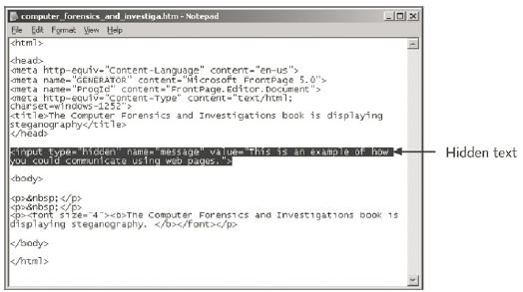
Understanding Steganography in Graphics Files

Slide 4
Understanding Steganography in Graphics Files
Substitution
Replaces bits of the host file with other bits of data
Usually change the last two LSBs (least significant bit)
Detected with steganalysis tools (a.k.a - steg tools)
You should inspect all files for evidence of steganography
Clues to look for:
Duplicate files with different hash values
Steganography programs installed on suspect’s drive

Slide 5
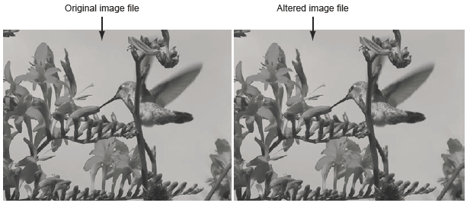
Understanding Steganography in Graphics Files

Slide 6
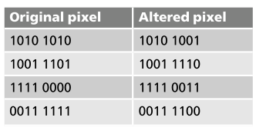
Understanding Steganography in Graphics Files
Bit breakdown of a secret message
Changing last bits does not perceptibly alter image

Slide 7
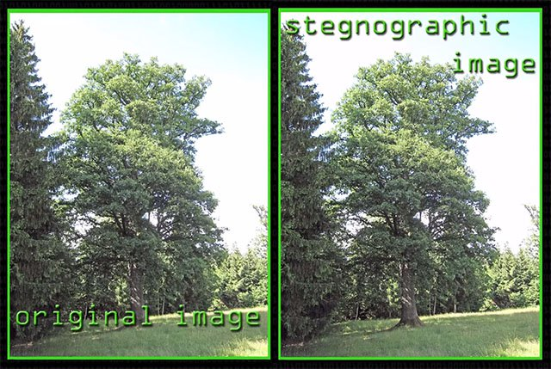
Understanding Steganography in Graphics Files

Slide 8
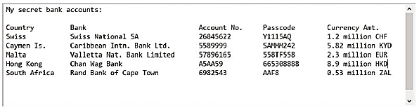
Understanding Steganography in Graphics Files
A hidden message in the altered image
Malware can be hidden via steganography!

Slide 9
Steganography
An offshoot of cryptography but not encryption although can use it
Secures a message through obscurity
Comes from the Greek word steganos, meaning “covered”
Message is there, although it’s invisible
A type of Obfuscation
Obfuscation is masking an item to render it unreadable but still usable
Hashed passwords are a good example of this
Advantage of Steganography (from hacker’s perspective)
The actual message does not attract attention

Slide 10
Common steganography techniques
Images
A message is embedded in an image
Network based
TCP packets have the message embedded inside them
Watermarks
Invisible to the eye on the paper
Audio
Hiding messages in an audio file
Video
Hiding messages in a video file

Slide 11
Using Steganalysis Tools
Use steg tools to detect, decode, and record hidden data
Detect variations of the graphic image
When applied correctly you cannot detect hidden data in most cases
Check to see whether the file size, hash, image quality, or file extensions have changed
Steghide is one we will use in the lab
OpenStego and StegOnline are other Steganalysis tools available , among others.

Slide 12
Examples of Steganography in Hacking
Hiding malware in images:
Attackers can embed malware code within images and send them to unsuspecting users
Once opened, the malware can be executed, compromising the user's system
Steganography in social engineering:
Attackers can hide malicious links or payloads within social media files
These links or payloads can be used to redirect users to phishing websites or exploit vulnerabilities
Copyright protection and watermarking:
Steganography can be used to embed copyright information or watermarks into digital content
This can help identify the owner of the content and prevent unauthorized use or distribution

Slide 13
Preventing Steganographic Attacks
Steganalysis Tools:
Use steganalysis tools to detect hidden information within digital files.
User Awareness and Education:
Encourage users to be cautious when opening or downloading files from unknown sources
Secure File Transfer Protocols:
Use secure file transfer protocols, such as HTTPS, SFTP, FTPS, as they encrypt the data, making it more difficult for attackers to hide information within it
Blocking users from downloading any image or media files may not be practical as these files are commonly used in business life.

Slide 14
Conclusion
Steganography is a powerful technique for hiding information in plain sight
It has been used for both legitimate and malicious purposes
Understanding steganography and its limitations is crucial for protecting against steganography-based attacks
Employing steganalysis tools, user awareness, and secure file transfer protocols can help mitigate the risks associated with steganography

